Slide 1
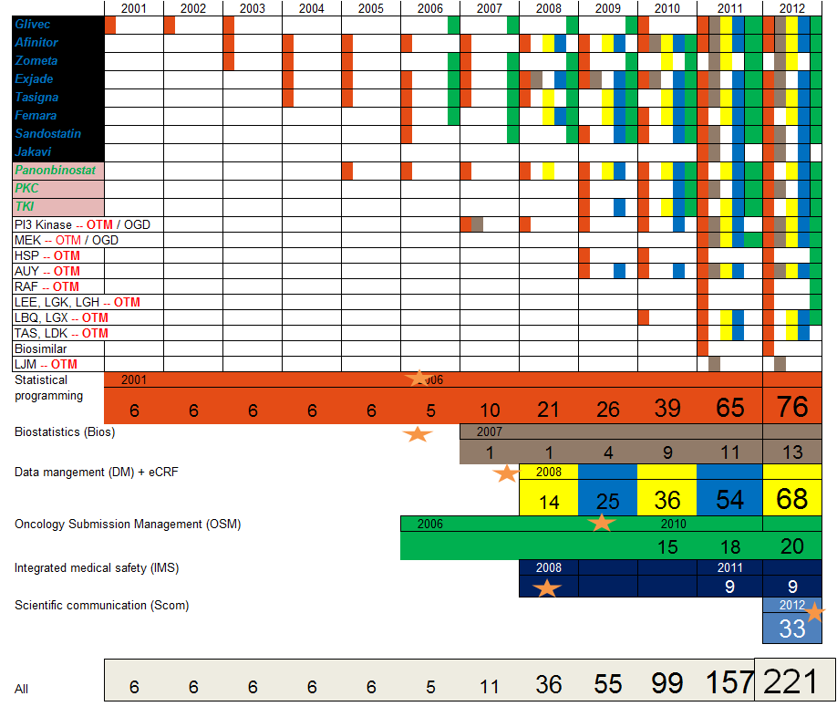
DRA 2

Slide 2
Hyderabad OGD footprint (2012)
47 projects ongoing in OGD: involvement in ~40 projects from Hyderabad
Approximately 65% of studies at least some contribution
Contributions to Regulatory submissions:
    SOM
    Afinitor
    ??? Any other submission
Contributions to OTM to FD (ADVANCE component as well):
    PI3K program
    TKI
    LDE
    LDK
Approximately 20 studies worked on by at least 3LFs from Hyderabad (CRF development, DM, CDRR, Bios, OSM, OSW, DRA)
Center of excellence for CRF development
* Data based on IMPACT list Oct 2012

